Slide 1

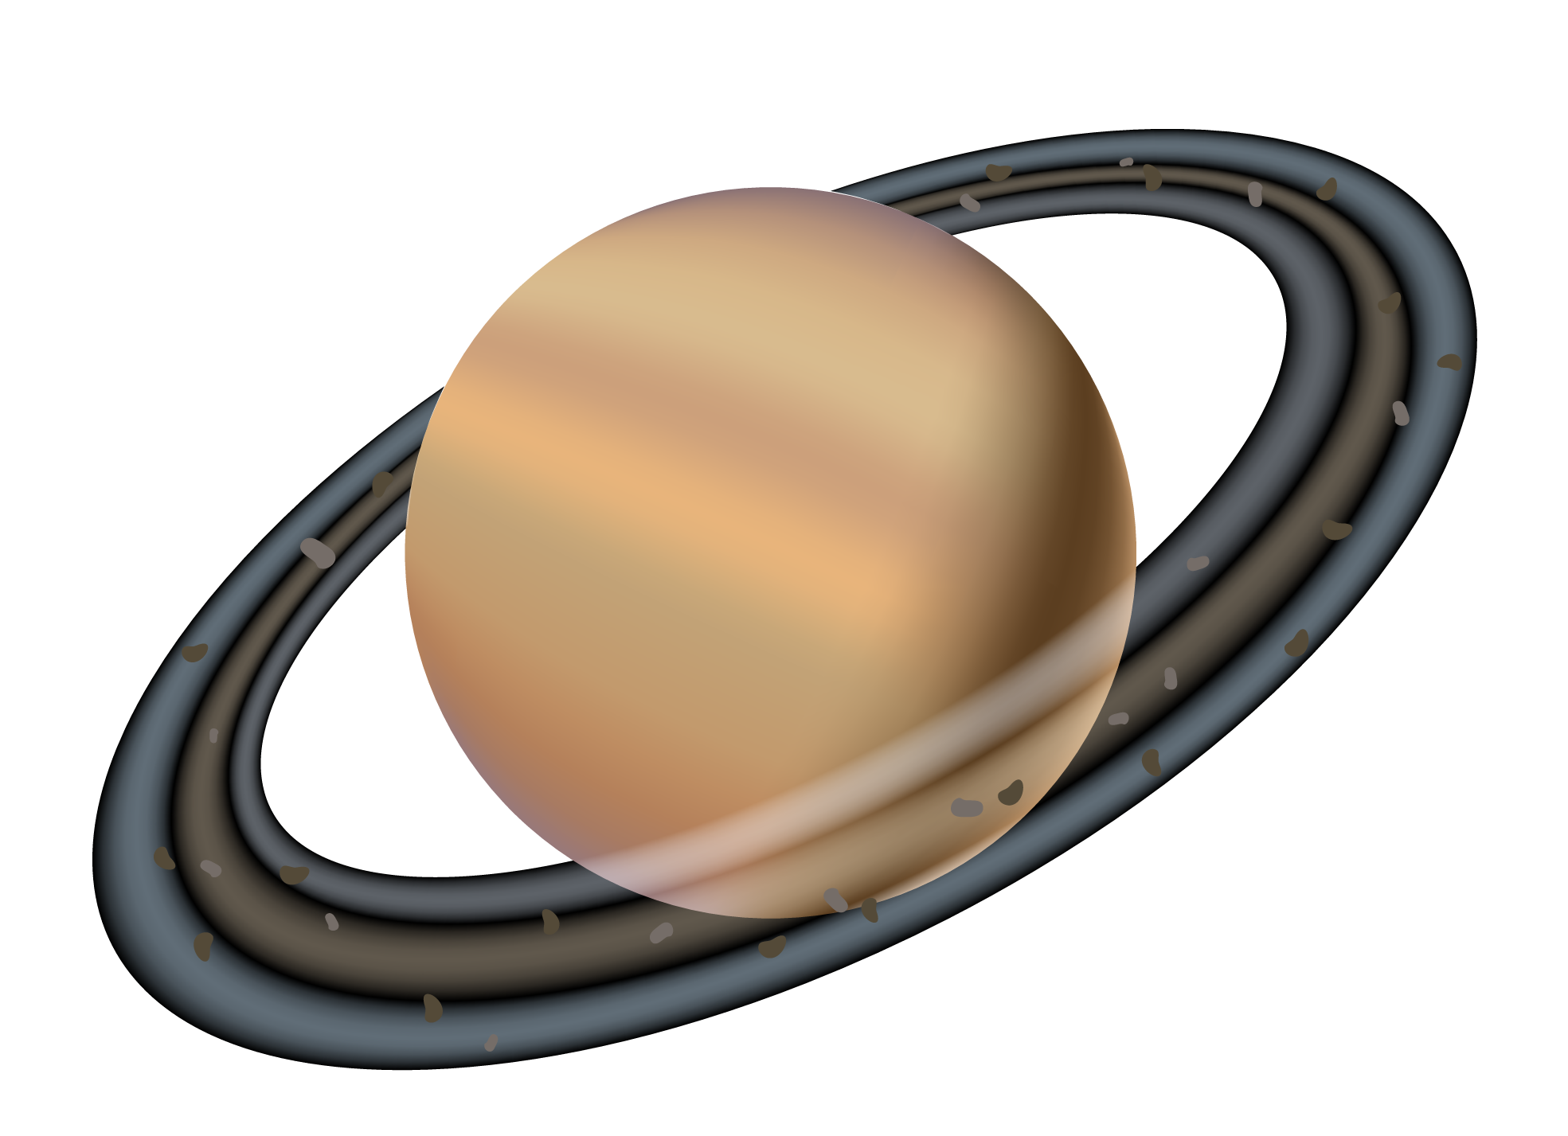

ASTROS

Slide 2
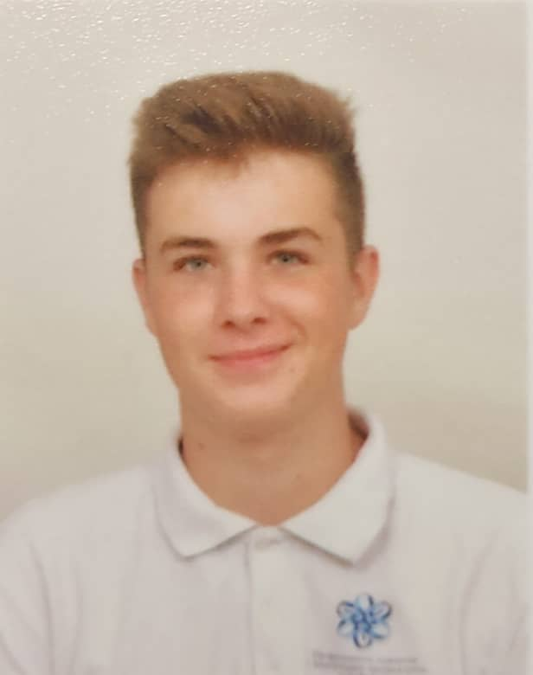
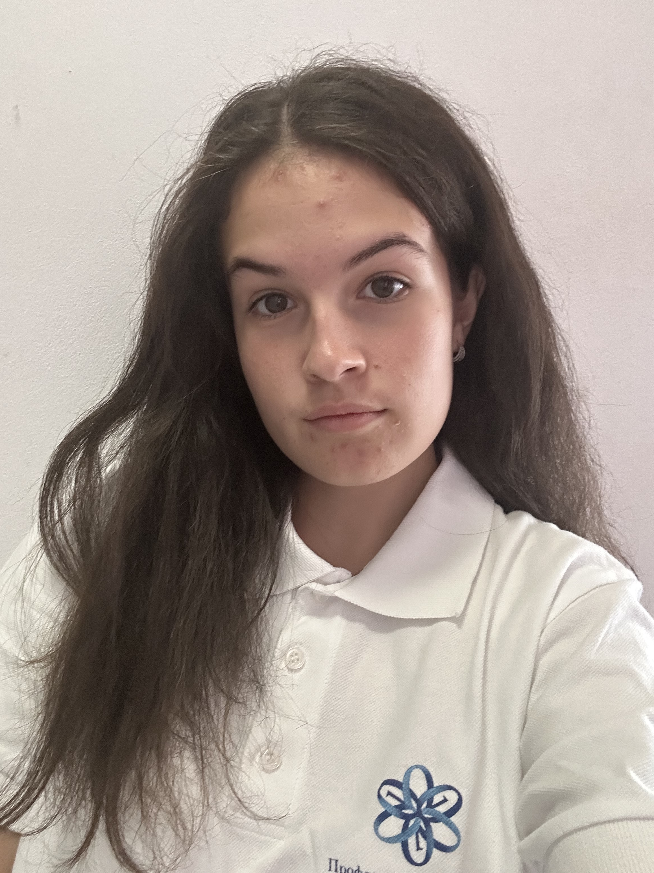
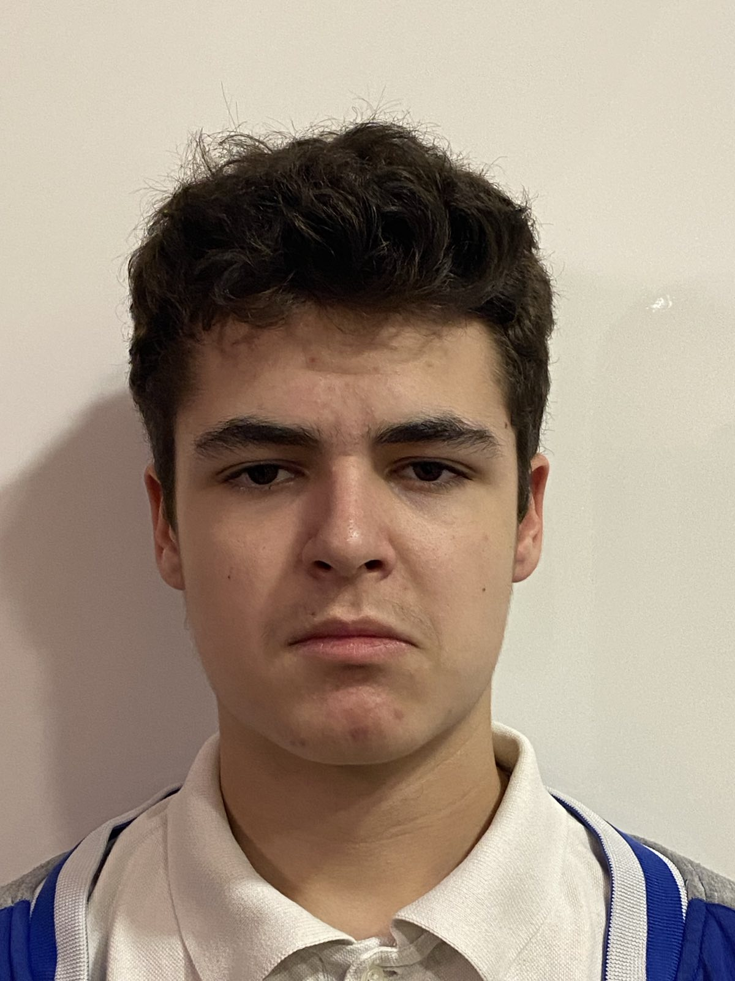
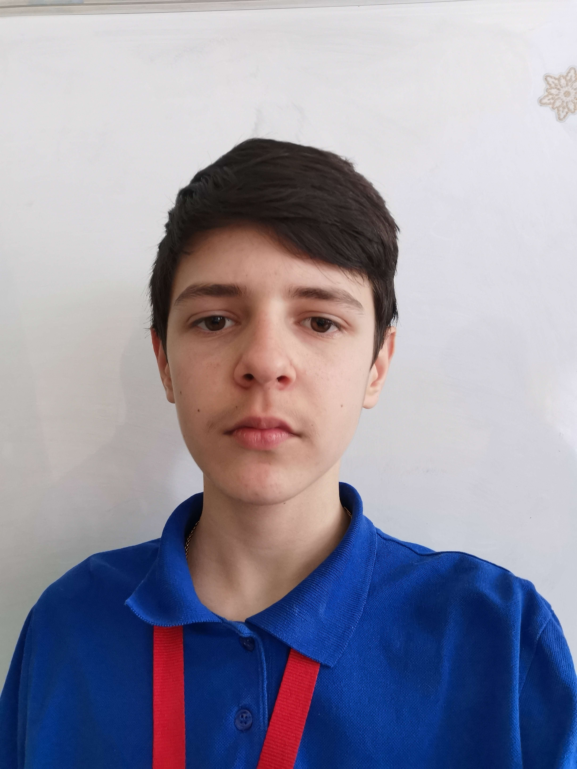
OUR TEAM
Hristo Rusev
Teodora Skulieva
Ivan-Mihail Ivanov
Zlatin Lazarov
Scrum Trainer
Back-end developer
Back-end developer
Back-end developer

Slide 3

STAGES OF CREATION​
Choose an idea
Make documentation
Make an application
1
3
2

Slide 4








Technologies

Slide 5


Let’s get to the application

